Slide 1
DATABASES WITH PYTHON

Slide 2
SQLite3
SQLite3 can be integrated with Python using sqlite3 module, which was written by Gerhard Haring.
Separate installation of this module is not required as it is shipped by default along with Python version 2.5.x onwards.

Slide 3
Python sqlite3 module APIs
sqlite3.connect(database [,timeout ,other optional arguments])
This API opens a connection to the SQLite database file. If database is opened successfully, it returns a connection object.
When a database is accessed by multiple connections, and one of the processes modifies the database, the SQLite database is locked until that transaction is committed. The timeout parameter specifies how long the connection should wait for the lock to go away until raising an exception. The default for the timeout parameter is 5.0 (five seconds).
If the given database name does not exist then this call will create the database. You can specify filename with the required path as well if you want to create a database anywhere else except in the current directory.
connection.cursor([cursorClass])
This routine creates a cursor which will be used throughout of your database programming with Python. This method accepts a single optional parameter cursorClass. If supplied, this must be a custom cursor class that extends sqlite3.Cursor.

Slide 4
Python sqlite3 module APIs
cursor.execute(sql [, optional parameters])
This routine executes an SQL statement. The SQL statement may be parameterized (i. e. placeholders instead of SQL literals). The sqlite3 module supports two kinds of placeholders: question marks and named placeholders (named style).
For example − cursor.execute("insert into people values (?, ?)", (who, age))
connection.execute(sql [, optional parameters])
This routine is a shortcut of the above execute method provided by the cursor object and it creates an intermediate cursor object by calling the cursor method, then calls the cursor's execute method with the parameters given.

Slide 5
Python sqlite3 module APIs
cursor.executemany(sql, seq_of_parameters)
This routine executes an SQL command against all parameter sequences or mappings found in the sequence sql.
connection.executemany(sql[, parameters])
This routine is a shortcut that creates an intermediate cursor object by calling the cursor method, then calls the cursor.s executemany method with the parameters given.
cursor.executescript(sql_script)
This routine executes multiple SQL statements at once provided in the form of script. It issues a COMMIT statement first, then executes the SQL script it gets as a parameter. All the SQL statements should be separated by a semi colon (;).

Slide 6
Python sqlite3 module APIs
connection.executescript(sql_script)
This routine is a shortcut that creates an intermediate cursor object by calling the cursor method, then calls the cursor's executescript method with the parameters given.
connection.total_changes()
This routine returns the total number of database rows that have been modified, inserted, or deleted since the database connection was opened.
connection.commit()
This method commits the current transaction. If you don't call this method, anything you did since the last call to commit() is not visible from other database connections.

Slide 7
Python sqlite3 module APIs
connection.rollback()
This method rolls back any changes to the database since the last call to commit().
connection.close()
This method closes the database connection. Note that this does not automatically call commit(). If you just close your database connection without calling commit() first, your changes will be lost!
cursor.fetchone()
This method fetches the next row of a query result set, returning a single sequence, or None when no more data is available.

Slide 8
Python sqlite3 module APIs
cursor.fetchmany([size = cursor.arraysize])
This routine fetches the next set of rows of a query result, returning a list. An empty list is returned when no more rows are available. The method tries to fetch as many rows as indicated by the size parameter.
cursor.fetchall()
This routine fetches all (remaining) rows of a query result, returning a list. An empty list is returned when no rows are available.

Slide 9
Connect to Database
import sqlite3
conn = sqlite3.connect('test.db')
print "Opened database successfully";

Slide 10
Create a Table
import sqlite3
conn = sqlite3.connect('test.db')
print "Opened database successfully"; conn.execute('''CREATE TABLE COMPANY
(ID INT PRIMARY KEY NOT NULL,
NAME TEXT NOT NULL,
AGE INT NOT NULL,
ADDRESS CHAR(50),
SALARY REAL);''')
print "Table created successfully";
conn.close()

Slide 11
INSERT Operation
import sqlite3
conn = sqlite3.connect('test.db')
print "Opened database successfully";
conn.execute("INSERT INTO COMPANY (ID,NAME,AGE,ADDRESS,SALARY) \
VALUES (1, 'Paul', 32, 'California', 20000.00 )");
conn.execute("INSERT INTO COMPANY (ID,NAME,AGE,ADDRESS,SALARY) \
VALUES (2, 'Allen', 25, 'Texas', 15000.00 )");
conn.execute("INSERT INTO COMPANY (ID,NAME,AGE,ADDRESS,SALARY) \ VALUES (3, 'Teddy', 23, 'Norway', 20000.00 )");
conn.execute("INSERT INTO COMPANY (ID,NAME,AGE,ADDRESS,SALARY) \ VALUES (4, 'Mark', 25, 'Rich-Mond ', 65000.00 )");
conn.commit()
print "Records created successfully";
conn.close()

Slide 12
SELECT Operation
import sqlite3
conn = sqlite3.connect('test.db')
print "Opened database successfully";
cursor = conn.execute("SELECT id, name, address, salary from COMPANY")
for row in cursor:
print "ID = ", row[0]
print "NAME = ", row[1]
print "ADDRESS = ", row[2]
print "SALARY = ", row[3], "\n"
print "Operation done successfully";
conn.close()

Slide 13
UPDATE Operation
import sqlite3
conn = sqlite3.connect('test.db')
print "Opened database successfully";
conn.execute("UPDATE COMPANY set SALARY = 25000.00 where ID = 1")
conn.commit
print "Total number of rows updated :", conn.total_changes
cursor = conn.execute("SELECT id, name, address, salary from COMPANY")
for row in cursor:
print "ID = ", row[0]
print "NAME = ", row[1]
print "ADDRESS = ", row[2]
print "SALARY = ", row[3], "\n"
print "Operation done successfully";
conn.close()

Slide 14
DELETE Operation
import sqlite3
conn = sqlite3.connect('test.db')
print "Opened database successfully";
conn.execute("DELETE from COMPANY where ID = 2;") conn.commit()
print "Total number of rows deleted :", conn.total_changes
cursor = conn.execute("SELECT id, name, address, salary from COMPANY")
for row in cursor:
print "ID = ", row[0]
print "NAME = ", row[1]
print "ADDRESS = ", row[2]
print "SALARY = ", row[3], "\n"
print "Operation done successfully";
conn.close()

Slide 15
Sample code- create db
import sqlite3
from sqlite3 import Error
def create_connection(db_file):
""" create a database connection to a SQLite database """
try:
conn = sqlite3.connect(db_file)
print(sqlite3.version)
except Error as e:
print(e)
finally:
conn.close()
if __name__ == '__main__':
create_connection("C:\\sqlite\db\pythonsqlite.db")
Notes:
http://www.sqlitetutorial.net/sqlite-python/creating-database/

Slide 16
Create db in memory
If you pass the file name as :memory: to the connect() function of the sqlite3 module, it will create a new database that resides in the memory (RAM) instead of a database file on disk.

Slide 17
import sqlite3
from sqlite3 import Error
def create_connection():
""" create a database connection to a database that resides
in the memory
"""
try:
conn = sqlite3.connect(':memory:')
print(sqlite3.version)
except Error as e:
print(e)
finally:
conn.close()
if __name__ == '__main__':
create_connection()

Slide 18
Creating Tables
def create_connection(db_file):
""" create a database connection to the SQLite database
specified by db_file
:param db_file: database file
:return: Connection object or None
"""
try:
conn = sqlite3.connect(db_file)
return conn
except Error as e:
print(e)
return None

Slide 19
def create_table(conn, create_table_sql):
""" create a table from the create_table_sql statement
:param conn: Connection object
:param create_table_sql: a CREATE TABLE statement
:return:
"""
try:
c = conn.cursor()
c.execute(create_table_sql)
except Error as e:
print(e)

Slide 20
def main():
database = "C:\\sqlite\db\pythonsqlite.db"
sql_create_projects_table = """ CREATE TABLE IF NOT EXISTS projects (
id integer PRIMARY KEY,
name text NOT NULL,
begin_date text,
end_date text
); """
sql_create_tasks_table = """CREATE TABLE IF NOT EXISTS tasks (
id integer PRIMARY KEY,
name text NOT NULL,
priority integer,
status_id integer NOT NULL,
project_id integer NOT NULL,
begin_date text NOT NULL,
end_date text NOT NULL,
FOREIGN KEY (project_id) REFERENCES projects (id)
);"""

Slide 21
# create a database connection
conn = create_connection(database)
if conn is not None:
# create projects table
create_table(conn, sql_create_projects_table)
# create tasks table
create_table(conn, sql_create_tasks_table)
else:
print("Error! cannot create the database connection.")
if __name__ == '__main__':
main()

Slide 22
Inserting Data
def create_project(conn, project):
"""
Create a new project into the projects table
:param conn:
:param project:
:return: project id
"""
sql = ''' INSERT INTO projects(name,begin_date,end_date)
VALUES(?,?,?) '''
cur = conn.cursor()
cur.execute(sql, project)
return cur.lastrowid

Slide 23
def create_task(conn, task):
"""
Create a new task
:param conn:
:param task:
:return:
"""
sql = ''' INSERT INTO tasks(name,priority,status_id,project_id,begin_date,end_date)
VALUES(?,?,?,?,?,?) '''
cur = conn.cursor()
cur.execute(sql, task)
return cur.lastrowid

Slide 24
def main():
database = "C:\\sqlite\db\pythonsqlite.db"
# create a database connection
conn = create_connection(database)
with conn:
# create a new project
project = ('Cool App with SQLite & Python', '2015-01-01', '2015-01-30');
project_id = create_project(conn, project)
# tasks
task_1 = ('Analyze the requirements of the app', 1, 1, project_id, '2015-01-01', '2015-01-02')
task_2 = ('Confirm with user about the top requirements', 1, 1, project_id, '2015-01-03', '2015-01-05')
# create tasks
create_task(conn, task_1)
create_task(conn, task_2)

Slide 25
Updating Data
def update_task(conn, task):
"""
update priority, begin_date, and end date of a task
:param conn:
:param task:
:return: project id
"""
sql = ''' UPDATE tasks
SET priority = ? ,
begin_date = ? ,
end_date = ?
WHERE id = ?'''
cur = conn.cursor()
cur.execute(sql, task)

Slide 26
def main():
database = "C:\\sqlite\db\pythonsqlite.db"
# create a database connection
conn = create_connection(database)
with conn:
update_task(conn, (2, '2015-01-04', '2015-01-06',2))
if __name__ == '__main__':
main()

Slide 27
Deleting Data
def delete_task(conn, id):
"""
Delete a task by task id
:param conn: Connection to the SQLite database
:param id: id of the task
:return:
"""
sql = 'DELETE FROM tasks WHERE id=?'
cur = conn.cursor()
cur.execute(sql, (id,))

Slide 28
def delete_all_tasks(conn):
"""
Delete all rows in the tasks table
:param conn: Connection to the SQLite database
:return:
"""
sql = 'DELETE FROM tasks'
cur = conn.cursor()
cur.execute(sql)

Slide 29
def main():
database = "C:\\sqlite\db\pythonsqlite.db"
# create a database connection
conn = create_connection(database)
with conn:
delete_task(conn, 2);
#delete_all_tasks(conn);
if __name__ == '__main__':
main()

Slide 30
Querying Data
def select_all_tasks(conn):
"""
Query all rows in the tasks table
:param conn: the Connection object
:return:
"""
cur = conn.cursor()
cur.execute("SELECT * FROM tasks")
rows = cur.fetchall()
for row in rows:
print(row)

Slide 31
def select_task_by_priority(conn, priority):
"""
Query tasks by priority
:param conn: the Connection object
:param priority:
:return:
"""
cur = conn.cursor()
cur.execute("SELECT * FROM tasks WHERE priority=?", (priority,))
rows = cur.fetchall()
for row in rows:
print(row)

Slide 32
def main():
database = "C:\\sqlite\db\pythonsqlite.db"
# create a database connection
conn = create_connection(database)
with conn:
print("1. Query task by priority:")
select_task_by_priority(conn,1)
print("2. Query all tasks")
select_all_tasks(conn)
if __name__ == '__main__':
main()

Slide 33
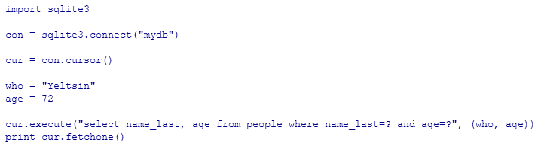

Slide 34
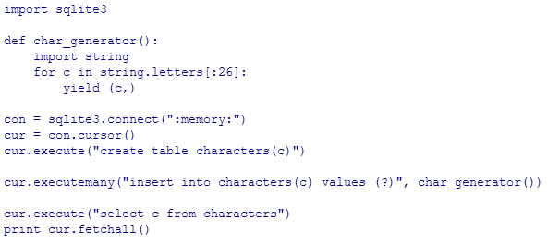

Slide 35
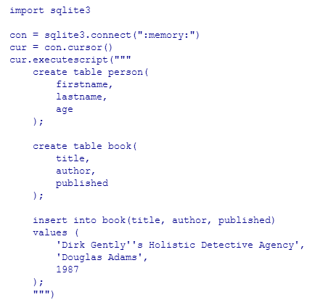

Slide 36
THANK YOU!!!

